Slide 1

BATTERY MANAGEMENT SYSTEM
GROUP 4
GOKUL
JOSH
ANAGHA
DARSHANA
ANAMIKHA

Slide 2

PROBLEM STATEMENT
Lithium-Ion Instability: Lithium-ion cells have narrow safety margins. Overcharging them or exposing them to excessive heat can lead to catastrophic thermal runaway, fires, or explosions.
Irreversible Cell Degradation: Drawing too much power or allowing the pack voltage to drop below critical thresholds permanently damages the internal chemistry, destroying the battery's capacity and lifespan.
Blind System Operation: Microcontrollers and external loads cannot natively read raw battery conditions, leaving the host system completely unaware of imminent power failures or critical hazards.
The Engineering Objective: To design and implement a low-cost, automated Battery Management System (BMS) that continuously monitors physical cell parameters — including voltage, current, and temperature — and executes rapid load disconnection to protect the battery pack during fault conditions.

Slide 3
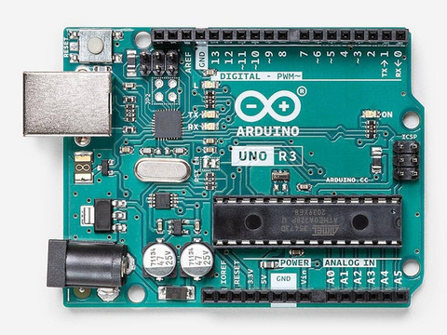
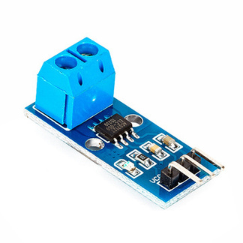
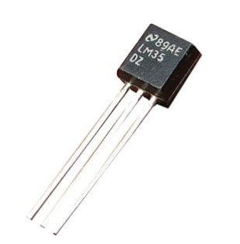
COMPONENTS REQUIRED
Arduino Uno R3
The Brain: Central microprocessing hub for the whole BMS.
ADC Reader: Converts 0V-5V analog signals into digital data .
Pins: Inputs data via pins A0-A2; outputs trip signals via pins D2-D3.
ACS712 Current Module
Amperage Tracker: Measures current flowing in or out of the battery pack.
Hall Effect: Translates magnetic fields from current into readable voltage.
0A Baseline: Outputs exactly 2.5V when no current is moving.
LM35 Temperature Sensor
Heat Sentinel: Placed directly near cells to continuously monitor battery temperature and catch overheating in real time
Direct Voltage Output: Outputs exactly 10mV per °C — no resistance conversion needed unlike NTC thermistor
Simple Connection: Only 3 pins needed — VCC, OUT and GND — no pull up resistor required
Accurate Reading: Gives precise temperature readings with ±0.5°C accuracy directly to Arduino A2 in range 0°C to 100°C

Slide 4
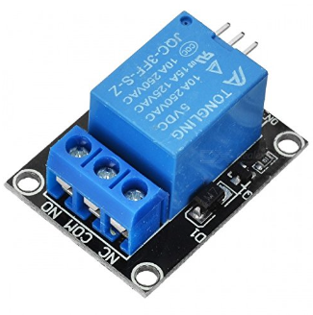
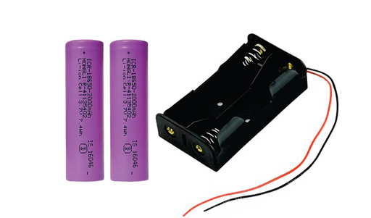
COMPONENTS REQUIRED
5V Single-Channel Relay
Circuit Breaker: Acts as a heavy-duty isolation switch during a fault condition, physically disconnecting the load from the battery pack.
Electromagnetic Operation: Low-power Arduino digital pin (D2) trips an internal coil to snap the contacts open, requiring minimal current to control high-power circuits.
Load Protection: When a fault is detected — overcurrent, overvoltage, undervoltage or overtemperature — the relay immediately disconnects the DC motor load to protect the battery pack.
18650 Lithium-Ion Battery Pack
The Powerhouse: Main energy source being monitored and protected.
Cell Configuration: 2S configuration (2 cells in series) giving an 8.4V}peak.
Voltage Limits: Operates strictly between 6.0V (empty) and 8.4V (full).
The Risk: Highly sensitive to over-discharge, over-charge, and fire risks (thermal runaway).
Voltage Divider Network
Voltage Scaler: Drops the raw battery pack voltage to a safe readable level for the Arduino analog pin.
Resistor Pair: Uses two series resistors — 30kΩ and 10kΩ — to step down the maximum battery voltage of 8.4V to approximately 2.1V at the midpoint.
Protection: Keeps the analog input voltage safely under 5V to prevent damage to the Arduino's ADC pin, while maintaining accurate proportional voltage readings.

Slide 5
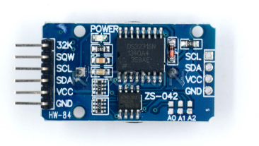
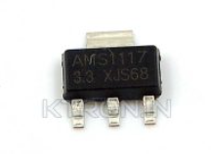
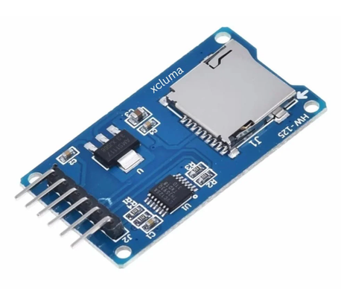
COMPONENTS REQUIRED
DS3231 RTC Module
Precision Timekeeper: Maintains exact real time using built in crystal oscillator — far more accurate than NE555 timer which drifts with temperature and component tolerance
I2C Communication: Connects to Arduino via only 2 wires — SDA on A4 and SCL on A5 — for two way data exchange
Alarm Function: Arduino sets precise 3 minute recovery alarm inside RTC via I2C before tripping relay during fault
Always Accurate: After exactly 3 minutes RTC notifies Arduino to restore power — no hardware resistors or capacitors needed to set time, just change a number in code
AMS1117 5V Voltage Regulator
Stable Power Supply: Converts fluctuating battery voltage 7.4V - 8.4V into clean stable 5V to keep Arduino always powered
Direct Battery Connection: Connected directly to battery positive — completely independent from relay switching — ensuring Arduino never loses power during fault or recovery
Protection: Shields Arduino from voltage spikes and fluctuations that could cause crashes or damage
Always Alive: Since Arduino is continuously powered via AMS1117, it can monitor sensors, count recovery time and control relay entirely on its own without needing external recovery components
SD Card Module
Data Logger: Records every fault event with exact timestamp, fault type, voltage, current and temperature
SPI Communication: Uses 4 wire SPI protocol on Arduino pins D11, D12, D13 and D10
Permanent Storage: Saves data to microSD in CSV format readable on any computer

Slide 6
WORKING
Stage 1: Raw Data Collection
Continuous Sampling: Sensors directly track battery pack's physical state in real time
Voltage Scaling: Voltage divider steps down battery voltage 6.0V - 8.4V into safe 0V - 2.1V window for Arduino
Signal Routing: Scaled voltage from divider, current readings from ACS712, and temperature from LM35 sent to Arduino pins A0, A1, and A2
Power Regulation: AMS1117 5V regulator converts battery voltage directly to stable 5V keeping Arduino always alive
Stage 2: Logic Evaluation
ADC Conversion: Arduino Uno converts incoming analog signals into digital values 0 to 1023
Unit Translation: Internal code applies math formulas to convert digital numbers into Volts, Amps and degrees Celsius
Threshold Checking: Code runs continuous loop comparing live values against built in safety limits
RTC Timekeeping: DS3231 RTC communicates with Arduino via I2C on pins A4 and A5 maintaining precise time tracking
Stage 3: Fault Execution
Over Voltage / Over Heat Fault: If voltage exceeds 8.4V or temperature crosses 45°C Arduino sends HIGH signal to D2 tripping relay and disconnecting motor load
Under Voltage / Over Current Fault: If voltage drops below 6.0V or current exceeds 5A Arduino triggers relay to disconnect load preventing further cell damage
Fault Logging: Arduino sets precise 3 minute recovery alarm in RTC via I2C before cutting power
Auto Recovery: After exactly 3 minutes RTC notifies Arduino via I2C, Arduino sets D2 LOW, relay closes, motor restarts and sensor check begins again
System Status: If all variables within safe limits relay remains closed and motor operates normally ✅

Slide 7
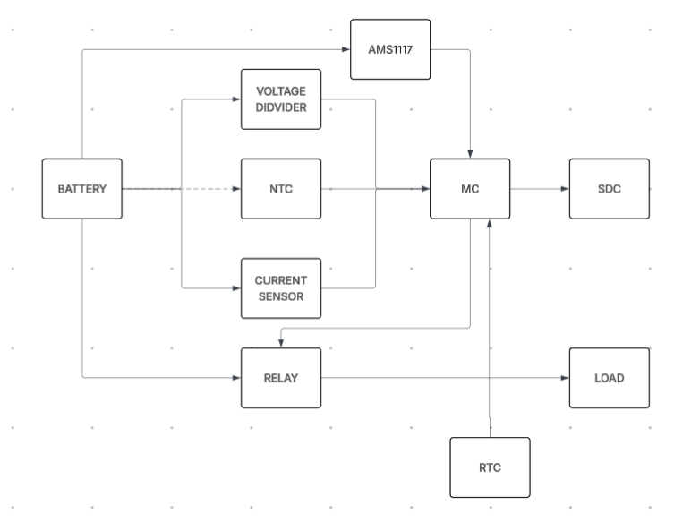
BLOCK DIAGRAM

Slide 8

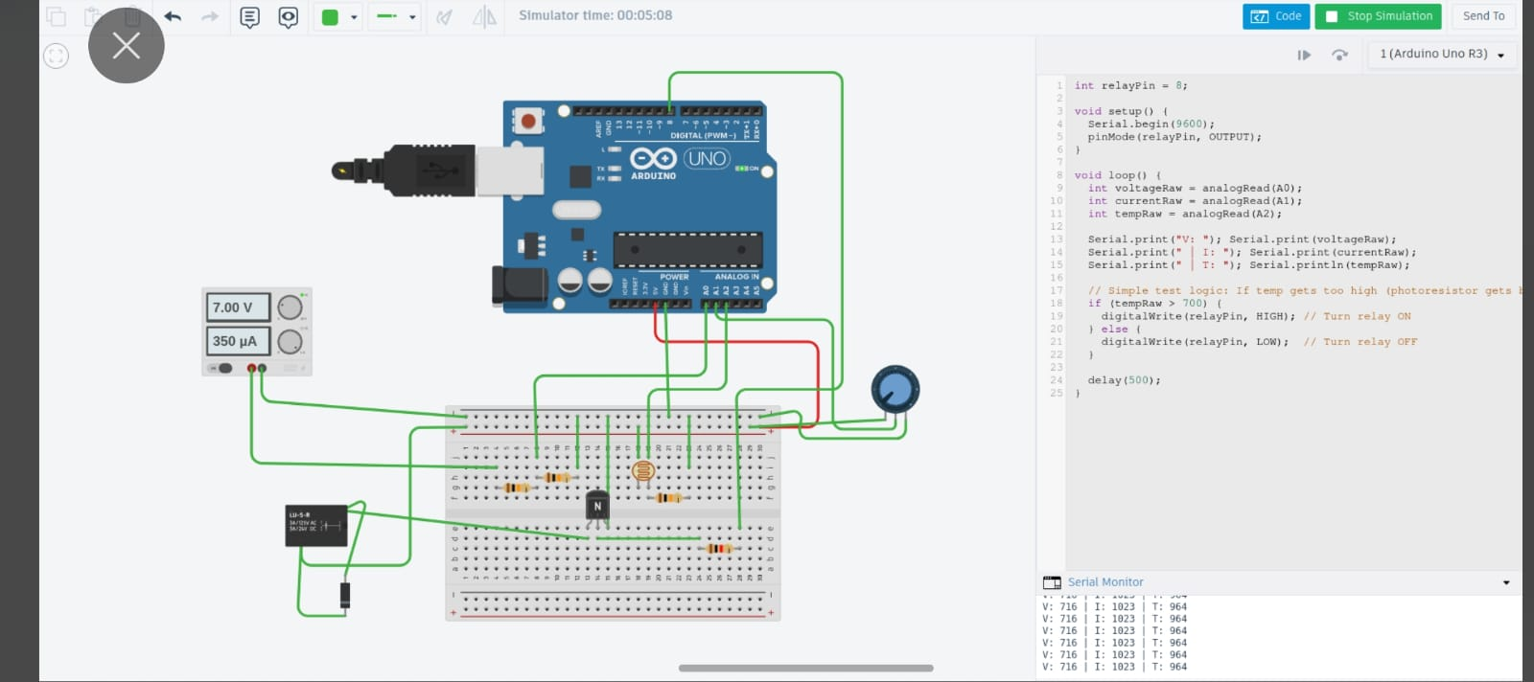
IMPLEMENTATION DIAGRAM

Slide 9
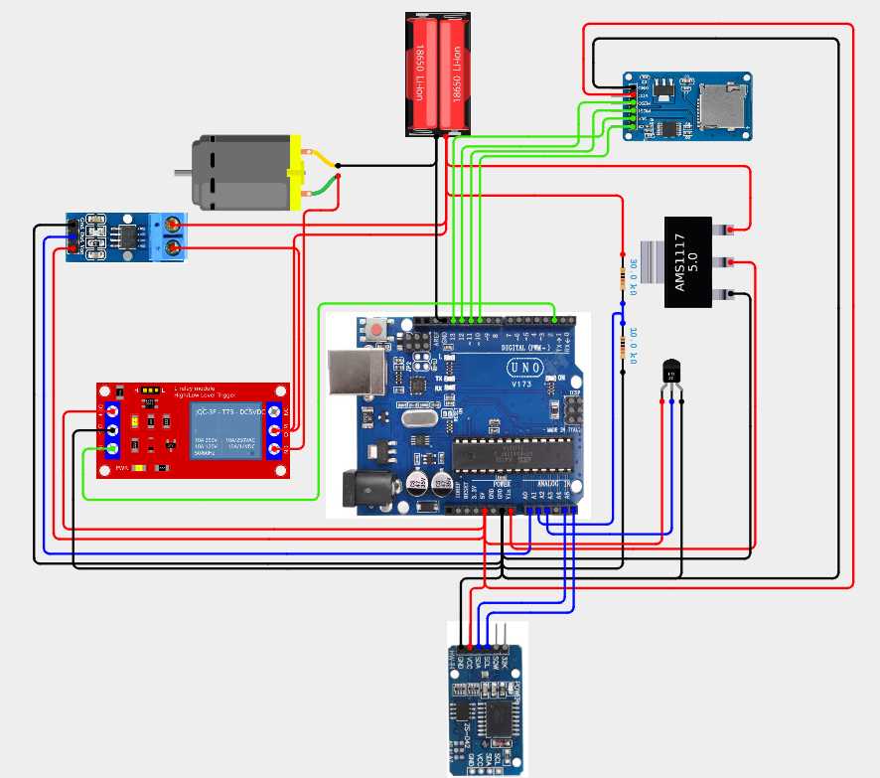
CIRCUIT DIAGRAM

Slide 10
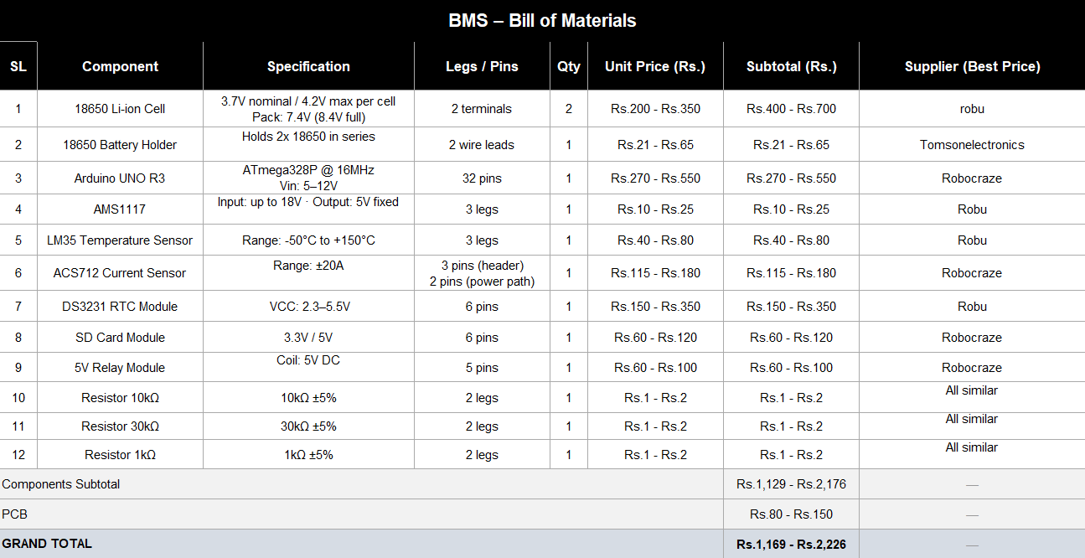

Slide 11
ADVANTAGES AND DISADVANTAGES
Advantages
Low Cost: Uses readily available components — Arduino, relay, ACS712 — keeping the total build cost minimal.
Real-Time Protection: Continuously monitors voltage, current and temperature simultaneously, reacting instantly to faults.
Modular Design: Each sensor operates independently, making it easy to troubleshoot or replace individual components.
Open Source: Arduino platform allows full code customization and easy future upgrades.
Disadvantages
No Cell Balancing: Cannot manage individual cell voltages in a multi-cell pack, leading to gradual cell mismatch over time.
Load Only Protection: Current design only disconnects the load during a fault — charger isolation requires additional hardware.
Analog Noise: Analog sensor readings are susceptible to electrical noise which can cause false fault triggers.
No SoC Estimation: Cannot calculate precise battery percentage — only monitors raw voltage as an approximation.

Slide 12
FUTURE SCOPE
1. Digital Protocols
CAN-bus / I2C: Upgrade from simple analog wires to a high-speed digital data bus.
Benefit: Eliminates electrical noise and allows communication with industrial microcontrollers.
2. Active Cell Balancing
Individual Monitoring: Track and manage the voltage of each individual 18650 cell.
Energy Transfer: Actively move power from stronger cells to weaker cells to maximize the pack's lifespan.
3. IoT & Wireless Monitoring
ESP32 Upgrade: Swap the Arduino Uno for an ESP32 microchip with onboard Wi-Fi and Bluetooth.
Cloud Dashboard: Stream live battery data directly to a mobile app or remote web server.
4. Smart State-of-Charge (SoC)
Coulomb Counting: Track the exact quantity of electrical charge entering and leaving the pack.
Accuracy: Replaces basic voltage-guessing with a precise, smartphone-like battery percentage.

Slide 13
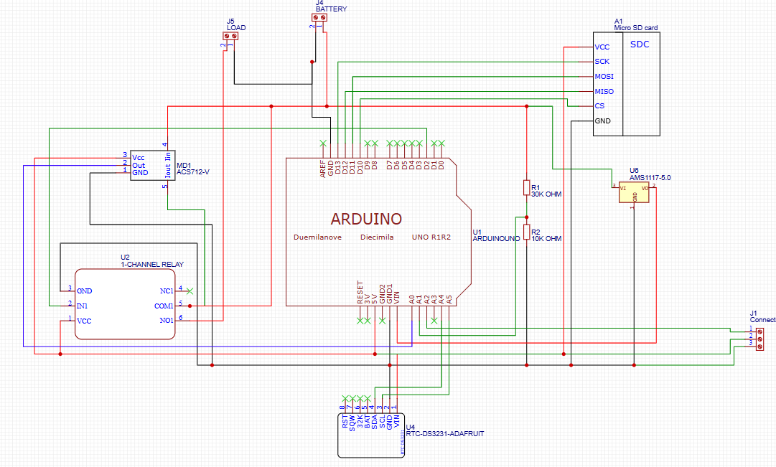
SCHEMATIC

Slide 14
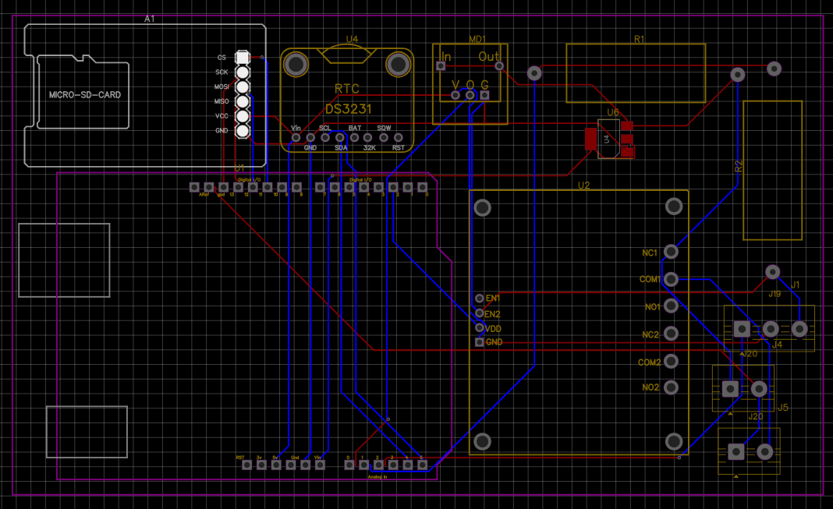
PCB

Slide 15
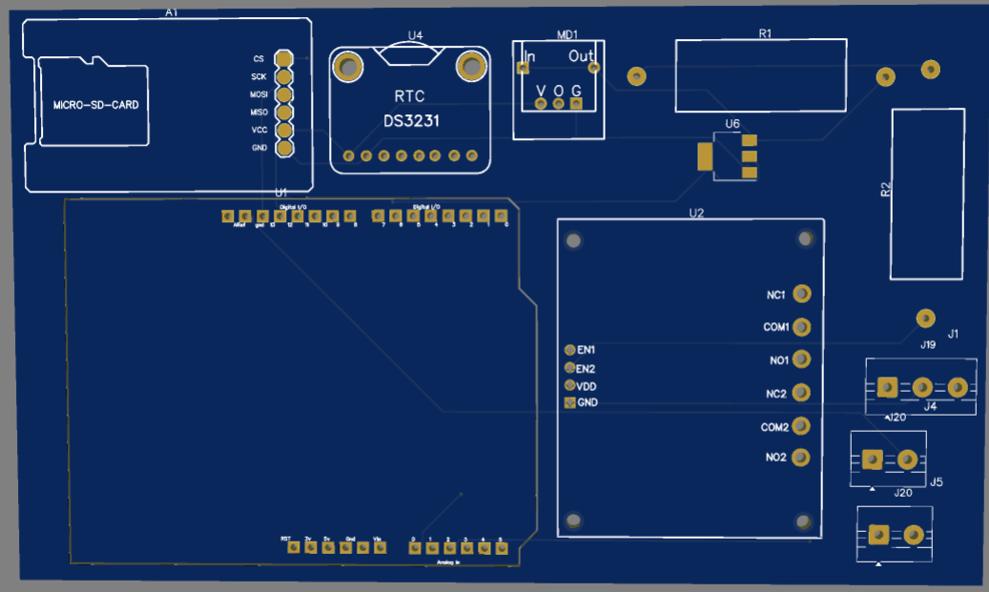
3D

